Slide 1
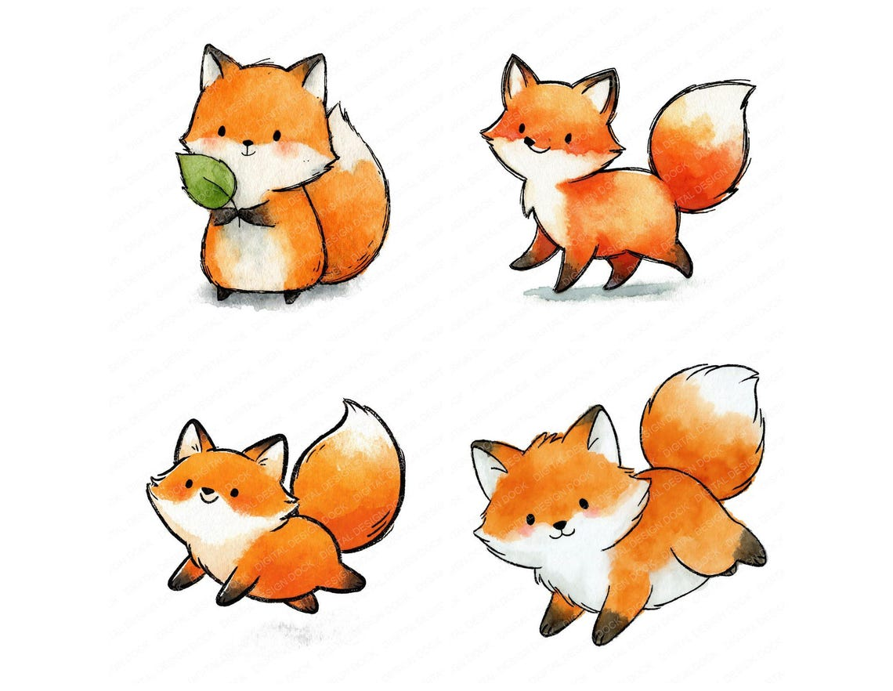
Fox class 26/27

Slide 2
About Fox class
Miss Seddon and Mrs Parker
Class rules – Ready, Respectful and Safe
Nurturing environment where children feel happy, confident, excited to learn and mistakes are celebrated!

Slide 3
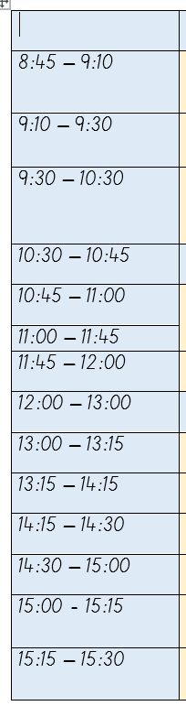
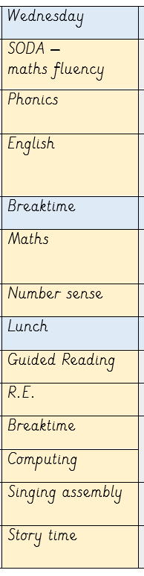
What does a typical day look like?

Slide 4
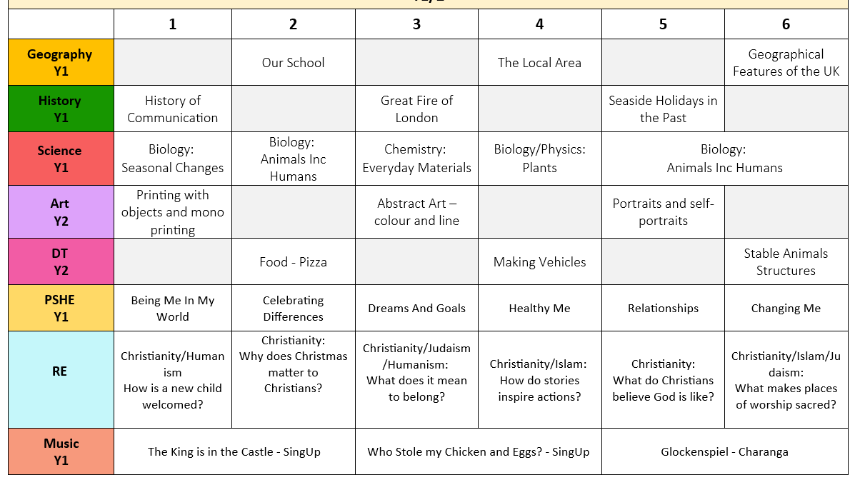
What will we be learning this year?

Slide 5
Maths
White Rose is the scheme we use for maths
Most important things for KS1 are number fact fluency
Year 1 - number bonds to 10 and 20 , doubles and 1 more/1 less
Year 2 – number bonds, doubles and near doubles, 2,3,5 and 10 times tables
Doodlemaths is brilliant for reinforcing what we've learnt in class

Slide 6
Phonics in school
Our phonics programme is Unlocking Letters and Sounds
Year 1 will continuing learning alternative phonemes. Year 2 will move onto spelling rules after Christmas with Mrs Parker
Their books are matched to their current phonics level

Slide 7
Reading at home
Please make sure you are reading regularly at home – our expectation is at least 5 times a week.
Doesn't have to be long
Encouraging them to spot the phonemes and blend them together and spot common exception words.
To extend - Ask questions about what has happened and characters’ feelings, support vocabulary, predict what will happen next and make connections

Slide 8
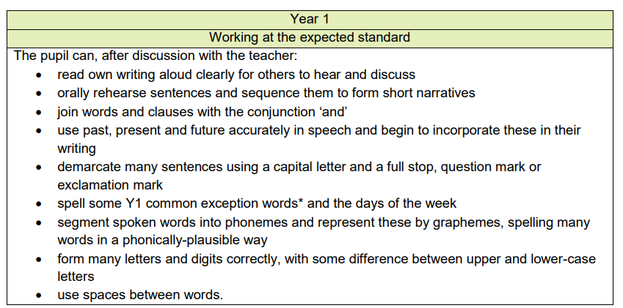
Writing and handwriting
Year 1

Slide 9
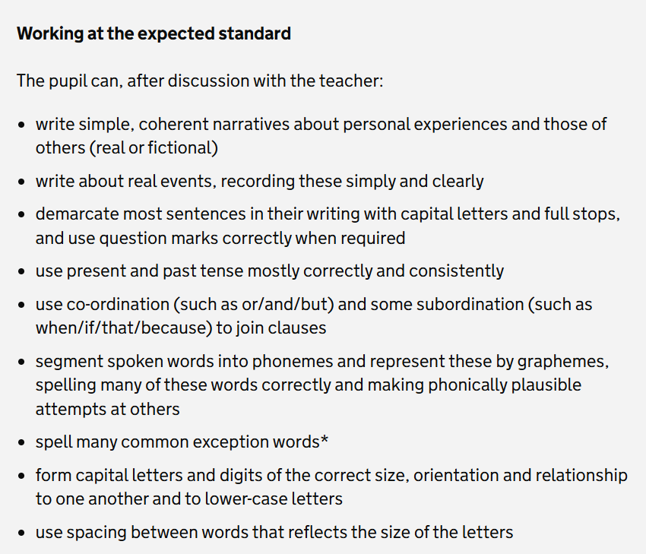
Writing and handwriting
Year 2

Slide 10
Homework
Reading 5 times a week (minimum)
Doodle maths twice a week

Slide 11
Practical information
P.E. is on Monday and Thursday
Water bottles everyday please
Reading books and records in bags every day if possible
We have fruit everyday for snack
Please make sure all clothing is named, if it's not named I put it in lost and found
Try not to let them bring in toys from home – they tend to get lost or broken!

Slide 12

Communication
Class dojo is best for quick messages or information.
If it's anything serious please contact the office as I'm not able to regularly check dojo.
If you have a concern please arrange a meeting.

Slide 13
Assessment
At the end of Year 1, the pupils will have their phonics screening check.
After Christmas and in summer term, the Year 2s will be doing some NFER tests.

Slide 14
Outdoor learning days?

Slide 15
Thank you!
Any questions?

